Slide 1

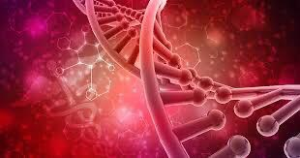
HORMONES AND ENVIRONMENTAL TRIGGERS

Slide 2
TABLE OF CONTENTS
OVERVIEW OF HORMONES AND ENVIRONMENTAL TRIGGERS
ESSENTIAL HORMONES AND FUNCTIONS
HOW ENVIRONMENTAL TRIGGERS IMPACT HORMONAL BALANCE
IMPORTANCE OF MAINTAINING HORMONAL BALANCE
DISEASES ASSOCIATED WITH HORMONAL IMBALANCE
PREVENTIVE MEASURES
CONCLUSION

Slide 3
Hormones play a crucial role in regulating various physiological processes in living organisms.
They are chemical messengers produced by the endocrine system and travel through the bloodstream to target cells.
Environmental triggers are factors in our surroundings that can affect the activities of hormones.
How environmental factors affect hormones differ from person to person.

Slide 4
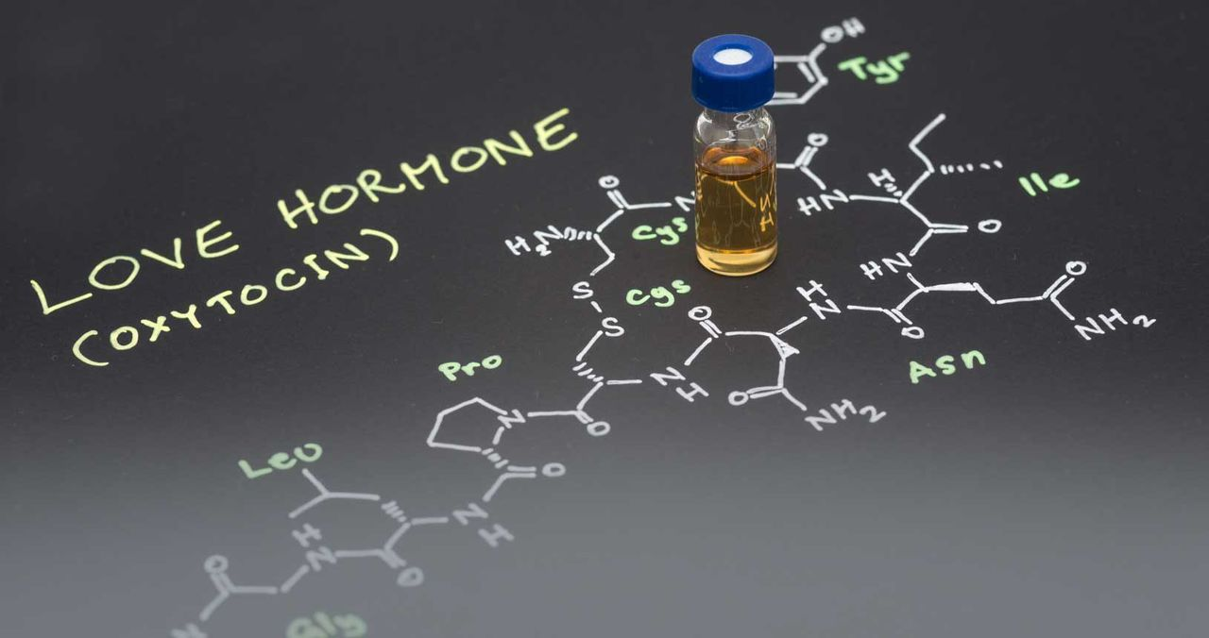
ESSENTIAL HORMONES AND FUNCTIONS
There are several essential hormones for body functions. These may include
OXYTOCIN

Slide 5
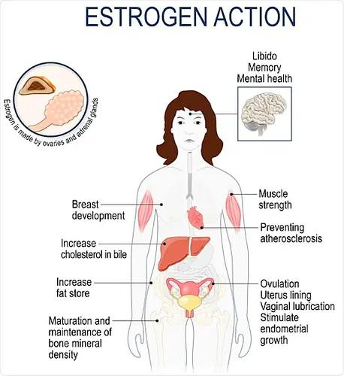
ESTROGEN

Slide 6
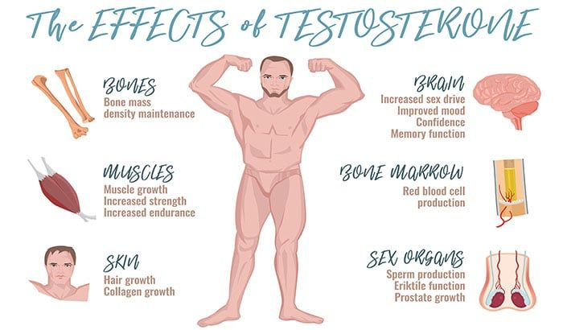
TESTOSTERONE

Slide 7
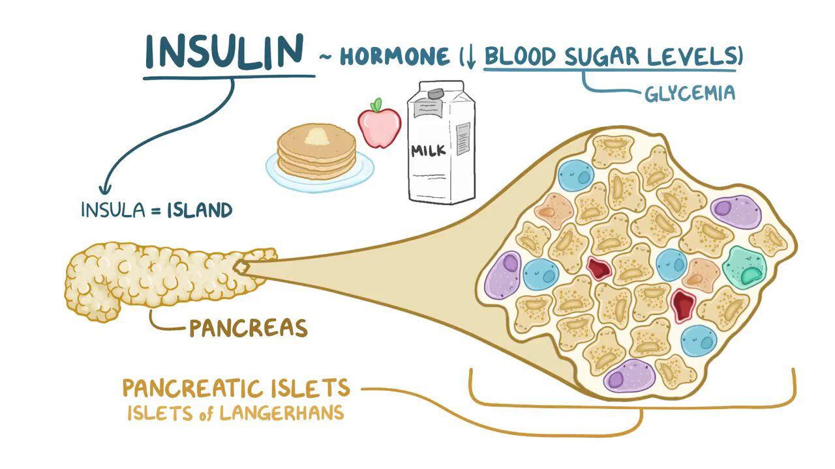
INSULIN
This is one of the most importance hormones in living organisms Responnsible for Glucose Regulation.

Slide 8
ENVIRONMENTAL TRIGGERS AND HORMONAL IMBALANCE
Stress.
Seasonal changes.
Endocrine disruptors.
Poor diet

Slide 9
IMPORTANCE OF HORMONAL BALANCE
Proper body functioning.
Prevents the risks of certain diseases
Improves energy levels
Improves reproductive health.

Slide 10
DISEASES ASSOCIATED WITH HORMONAL IMBALANCE
Polycystic Ovarian Syndrome(PCOS)
Diabetes
Thyroid disorders
Reduction in libido
Neurological conditions

Slide 11
PREVENTIVE MEASURES TO HORMONAL DISEASES
Surgery
Medication
Chemotherapy
Hormone diet
Hormonal replacement therapy

Slide 12
CONCLUSION
In conclusion, there are several environmental factors that triggers specific hormones to regulate specific functions for normal body regulation.
We therefore urge the need for more research in the field of genetics to further understand the activities of hormones and how hormonal balances can be achieved.

Slide 13
REFERENCES
Chrousos,G. P(2009) . Stress and disorders of the stress system.Nature Review Endocrinology, 5(7), 381.)
Wehr, T. a. (2001). Seasonal affective disorders: a history overview. Journal of biological rhythms, 16(3), 207- 227.)
AMERICAN DIABETES ASSOCIATION. (2019). 2. CLASSIFICATION AND DIAGNOSIS OF DIABETESS:STANDARD OF MEDICAL CARE IN DIABETES-2019. DIABETES CARE 42(SUPPLEMENT 1), S13-S28

Slide 14
THANK
YOU.

